Slide 1
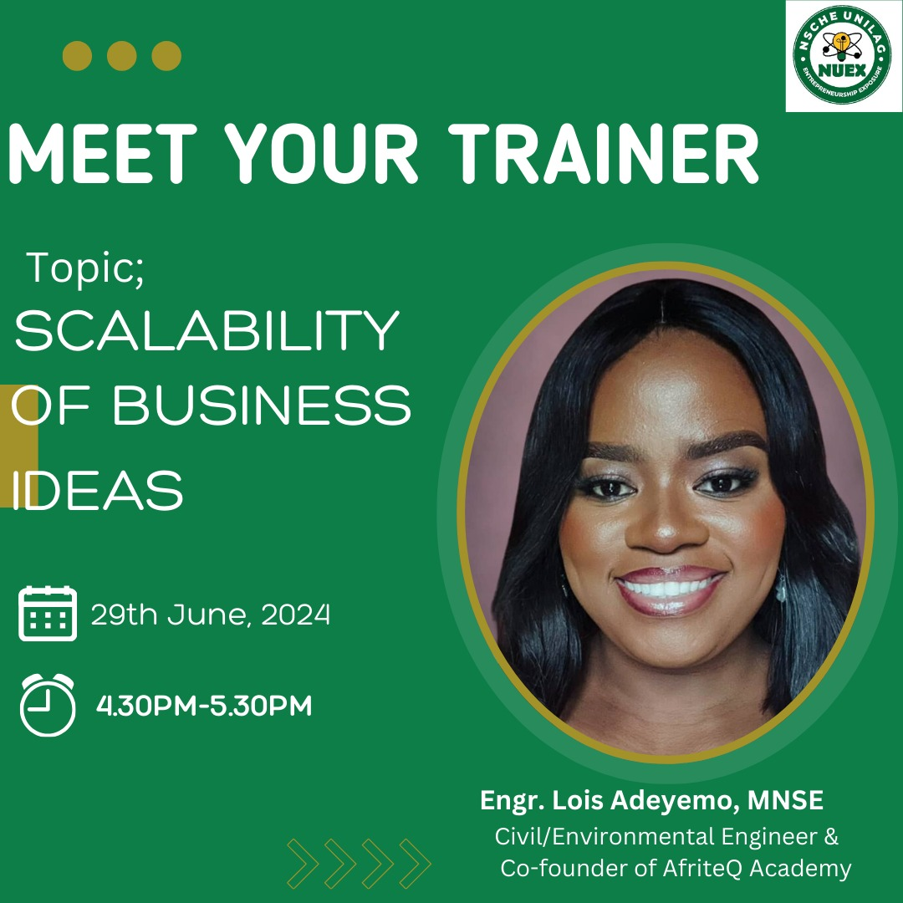
adelois
June 29, 2024
Scalability of
Business Ideas
To understand the concepts of scalability and how it applies to business ideas.
Presented by
www.adelois.com
info@adelois.com
adeyemola@gmail.com
Toronto, ON, Canada
Engr. Lois Adeyemo, MNSE
Civil/Environmental Engineer & Co-founder of AfriteQ Academy

Slide 2
adelois
June 29, 2024
Scalability of
Business Ideas
To understand the concepts of scalability and how it applies to business ideas.
Presented by
www.adelois.com
info@adelois.com
adeyemola@gmail.com
Toronto, ON, Canada
Engr. Lois Adeyemo, MNSE
Civil/Environmental Engineer & Co-founder of AfriteQ Academy

Slide 3
adelois
June 29, 2024
Content
Good day to
everyone
Greetings
How I Started - My Story
Introduction - Business Idea
Introduction - Scalability
Introduction - Feasibility
Class Exercise
www.adelois.com
info@adelois.com
adeyemola@gmail.com
Toronto, ON, Canada
01

Slide 4
adelois
June 29, 2024
How I Started - My Story
Be Ready to Fail!
About AfriteQ Academy
www.afriteqacademy.com
afriteqacademy@gmail.com
@afriteqacademy @engineeringsummercamp
www.adelois.com
info@adelois.com
adeyemola@gmail.com
Toronto, ON, Canada
02

Slide 5
adelois
June 29, 2024
Introduction
What is a Business Idea?
A business idea is a concept that can be used for financial gain, typically centered on a product or service that can be offered for money. It is the first step in the development of a business. A business idea is not just about having an innovative product or service but also about recognizing the need for that product or service in the market, identifying the target audience, and understanding how to deliver it effectively.
www.adelois.com
info@adelois.com
adeyemola@gmail.com
Toronto, ON, Canada
03

Slide 6
adelois
June 29, 2024
Introduction
What is Scalability?
Scalability refers to the ability of a business, system, or process to handle increased levels of demand, workload, or growth without compromising performance or efficiency. In the context of a business, scalability means the company can grow its revenue, customer base, and operations while maintaining or improving its operational efficiency and profitability.
www.adelois.com
info@adelois.com
adeyemola@gmail.com
Toronto, ON, Canada
04

Slide 7
adelois
June 29, 2024
Introduction
What is Feasibility?
Feasibility refers to the practicality and viability of a proposed project, business idea, or plan. It involves an assessment of various factors to determine whether the project can be successfully implemented within the available resources, time, and constraints. A feasibility study typically considers technical, economic, legal, operational, and scheduling aspects to provide a comprehensive analysis of the project's potential for success.
www.adelois.com
info@adelois.com
adeyemola@gmail.com
Toronto, ON, Canada
05

Slide 8
adelois
June 29, 2024
SWOT
Strengths
Unique Selling Proposition (USP), Strong Brand or Reputation, Experienced Team, Financial Resources, Technology and Innovation
Weaknesses
ANALYSIS
Limited Resources, Lack of Experience, Poor Location, Operational Challenges
Opportunities
Market Demand, Expansion Potential, Technological Advancements, Strategic Partnerships Regulatory Changes
A SWOT analysis is a useful tool for evaluating the Strengths, Weaknesses, Opportunities, and Threats associated with a business idea.
Threats
Competition, Economic Downturns, Regulatory Risks, Market Saturation, Technological Changes
www.adelois.com
info@adelois.com
adeyemola@gmail.com
Toronto, ON, Canada
06

Slide 9
adelois
June 29, 2024
Class Exercise:
Suggest a Business Idea!
www.adelois.com
info@adelois.com
adeyemola@gmail.com
Toronto, ON, Canada
07

Slide 10
adelois
June 29, 2024
Business Idea: InvertRe
Inverters for Remote Work
www.adelois.com
info@adelois.com
adeyemola@gmail.com
Toronto, ON, Canada
08

Slide 11
adelois
June 29, 2024
Team Members:
Ruth – f - COO
Joseph – m - CEO
Nofisat – f - CFO
www.adelois.com
info@adelois.com
adeyemola@gmail.com
Toronto, ON, Canada
09

Slide 12
Ruth – f - COO
Joseph – m - CEO
Nofisat – f - CFO
adelois
June 29, 2024
Feasibility Study - Technical Feasibility
What technology is needed?
Does the team have the necessary skills?
Is the infrastructure available?
Solar Panel
Batteries
Automatic Switch System
Website – E-commerce platform
Social Media platform
Laptop & Phone
Project management
Financial skills
Customer service
Communication
J & R has experience in web design
N has experience in graphic design
Sales and Marketing
Customer relations
Investment – angel investors, money gift
Partnerships with third-party companies
List technical skills of team members
www.adelois.com
info@adelois.com
adeyemola@gmail.com
Toronto, ON, Canada
10

Slide 13
adelois
June 29, 2024
Feasibility Study - Economic Feasibility
What are the estimated costs (startup, operational)?
What are the potential funding sources?
What are the projected revenues and profitability?
Website - $5000
Solar Panels - $100,000
Batteries - $5,000
Laptop(s)
Phones
Personal money
Friends and family
Investor B series
Grants
Bank loans
Revenue in first year - $150,000
Gross margin – 40%
www.adelois.com
info@adelois.com
adeyemola@gmail.com
Toronto, ON, Canada
11

Slide 14
adelois
June 29, 2024
Feasibility Study - Legal Feasibility
What are the regulatory requirements?
Are there any legal barriers or considerations?
Government policies
Regulatory bodies
Standard organisations
Competitors
Copyright
A member of the team
Stealing of trademark
A member of the team
Bad equipment’s
www.adelois.com
info@adelois.com
adeyemola@gmail.com
Toronto, ON, Canada
12

Slide 15
adelois
June 29, 2024
Feasibility Study - Operational Feasibility
Can the business sustain operations efficiently?
What operational challenges might arise?
COO manage inventory and order processing
COO manages customer support anf logistics
COO/CEO/CFO – writing proposals and reports (monthly, quarterly, half a year, annually)
CEO seeks for grants and partnerships
CEO in charge of overall production and process
CFO managing sales, revenue, income, input, output
CFO managing grants and funding
Bad feedback
Bad management
Failed equipment's
Stolen materials
Delivery issues
Team members bad attitude
Scammers
www.adelois.com
info@adelois.com
adeyemola@gmail.com
Toronto, ON, Canada
13

Slide 16
adelois
June 29, 2024
Feasibility Study - Scheduling Feasibility
What is the timeline for implementation?
What are the critical milestones?
Website - 3 months
Marketing campaign – 4 months
Completed timeline objectives
www.adelois.com
info@adelois.com
adeyemola@gmail.com
Toronto, ON, Canada
14

Slide 17
adelois
June 29, 2024
Evaluate Scalability - Capacity Handling
How can production or service delivery be increased?
Outsource delivery to dispatch riders
Outsource installation team
Improve website
Give promos to returning customers
Improve marketing strategy
www.adelois.com
info@adelois.com
adeyemola@gmail.com
Toronto, ON, Canada
15

Slide 18
adelois
June 29, 2024
Evaluate Scalability - Resource Management
How can resources be efficiently used?
Automation for order processing and inventory management
Implement customer relationship management system
Regular inventory and customer feedback
www.adelois.com
info@adelois.com
adeyemola@gmail.com
Toronto, ON, Canada
16

Slide 19
adelois
June 29, 2024
Evaluate Scalability - Technology
What scalable technologies can be leveraged?
Company website ---→ Jumia, Shopify, Kijiji, Nairaland, Konga, Kora (third-party services)
Bot chat, WhatsApp ordering, Bulk SMS and emails
www.adelois.com
info@adelois.com
adeyemola@gmail.com
Toronto, ON, Canada
17

Slide 20
adelois
June 29, 2024
Evaluate Scalability - Process Efficiency
How can processes be standardized or automated?
Employ staff
Develop a standardized workflow
Optimize website from order to delivery, track shipping, customer notifications for shipping
www.adelois.com
info@adelois.com
adeyemola@gmail.com
Toronto, ON, Canada
18

Slide 21
adelois
June 29, 2024
Evaluate Scalability - Market Reach
How can the customer base be expanded?
Target international markets through global shipping options.
Customer reviews and referrals
Discounts and offer
Videos
Paid ads
Customised handbills and swags
Sponsor/Partner a conference or event
Advertise in event brochures
Word of mouth – evangelism
www.adelois.com
info@adelois.com
adeyemola@gmail.com
Toronto, ON, Canada
19

Slide 22
adelois
June 29, 2024
Evaluate Scalability - Operational Flexibility
How can the business adapt to changes in demand?
Introduce new products with solar panel – bulbs, torchlights, fans, car, greenhouses, blender
Stay updated with trends, watch your competitors
www.adelois.com
info@adelois.com
adeyemola@gmail.com
Toronto, ON, Canada
20

Slide 23
adelois
June 29, 2024
Thank you!
For your attention.
www.adelois.com
info@adelois.com
adeyemola@gmail.com
Toronto, ON, Canada
21

